Slide 1
ANIMALS
PLAN:
To know new words
To write down words into vocabularies
To do some exercises
To learn a poem about animals
To write down homework

Slide 2
NEW WORDS
An animal – animals
A wild animal
A domestic animal
A sea animal
An insect
They live in …
Pandas live in …
A cat lives in …
Where do pandas live?
Where does a cat live?
To be hungry
At night
In the day
To hunt
To sleep
To eat
Strong
Cuddly

Slide 3
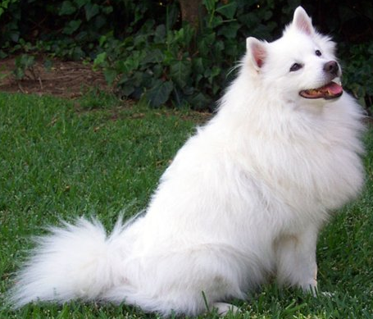
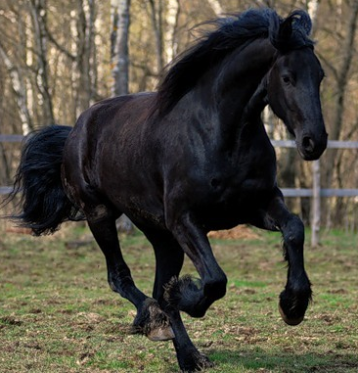
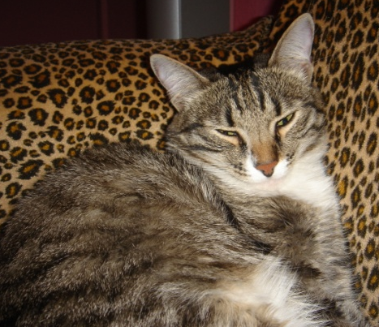
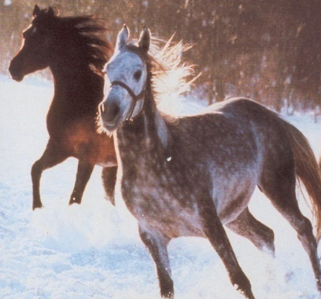
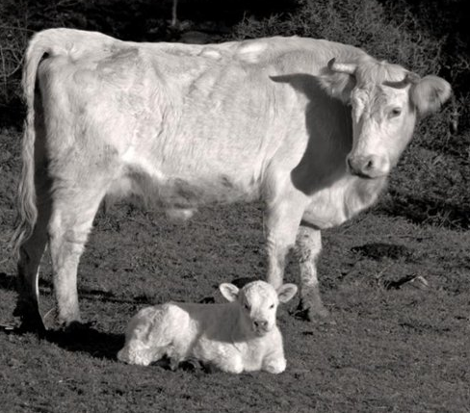
DOMASTIC ANIMALS
A cat – cats A dog - dogs
A horse – horses A cow - cows

Slide 4
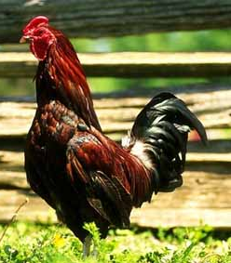
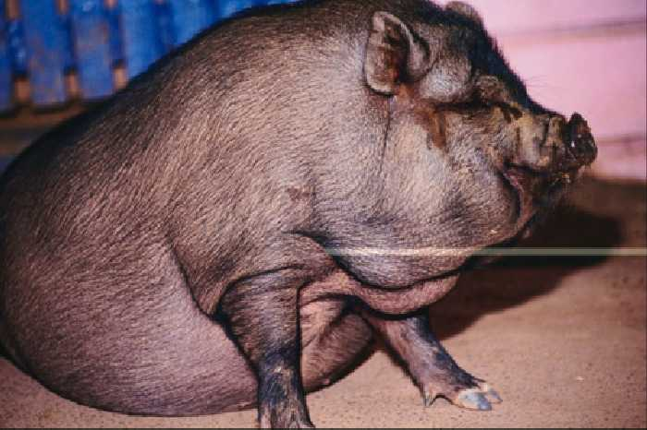
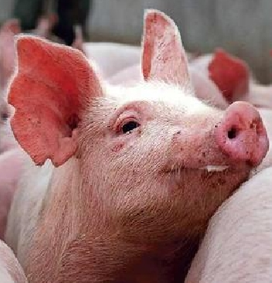
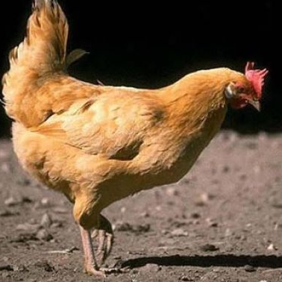
DOMASTIC ANIMALS
DOMASTIC BIRDS
A pig - pigs
A goose - geese
A cockerel - cockerels
A hen - hens
A chicken - chickens

Slide 5
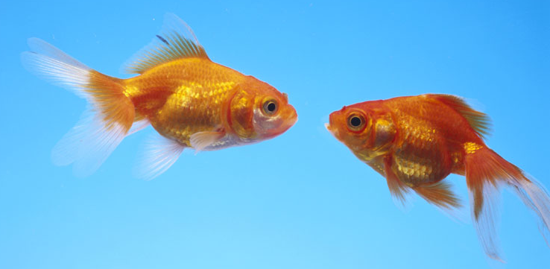
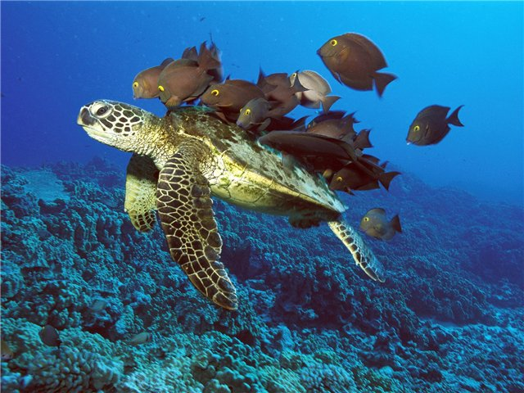
SEA ANIMALS
A fish – fish
A turtle - turtles
A dolphin – dolphins
A whale - whales

Slide 6
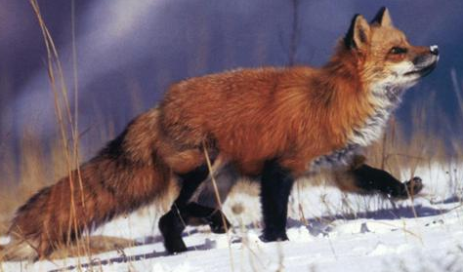
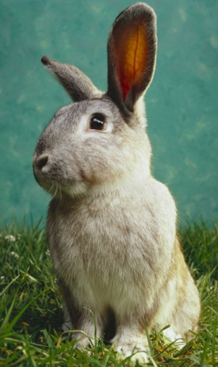
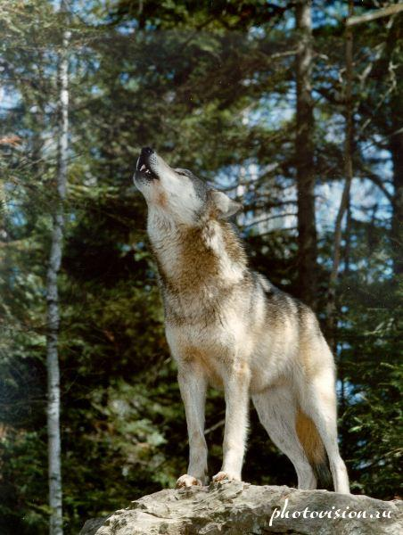
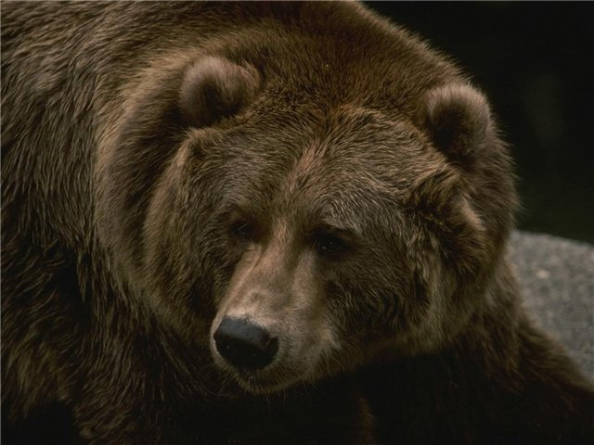
WILD ANIMALS
A fox – foxes
A wolf – wolves
A bear – bears
A squirrel – squirrels
A rabbit – rabbits
A hedgehog - hedgehogs

Slide 7
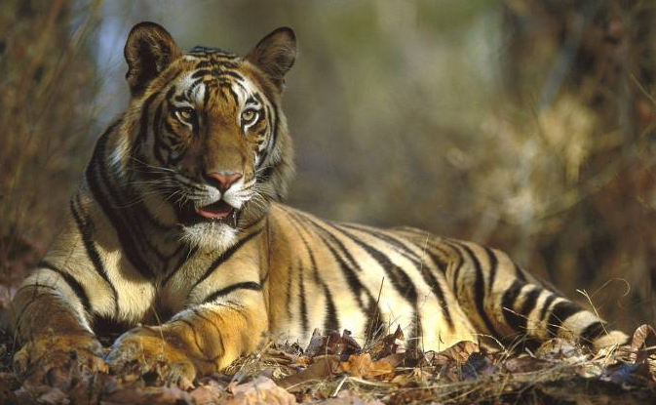
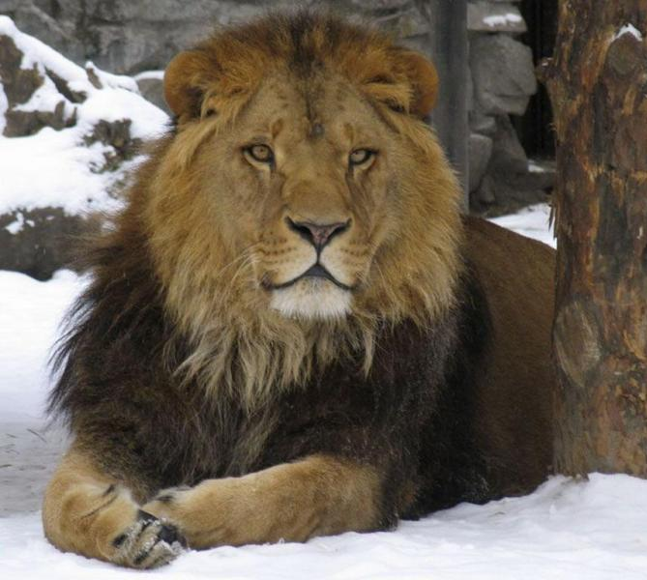
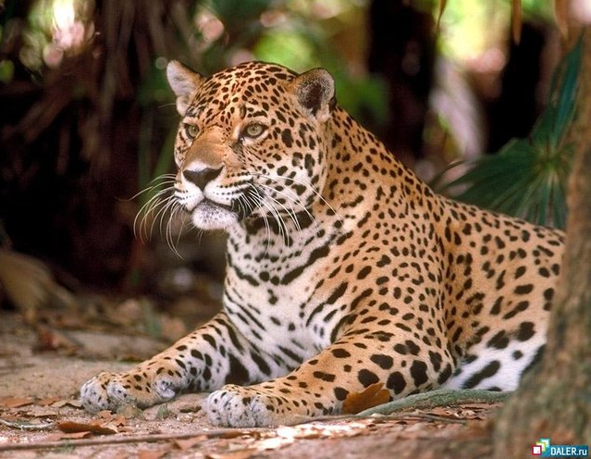
WILD ANIMALS BIG CATS
A tiger – tigers
A white tiger (an Indian tiger)
A lion – lions
A leopard - leopards

Slide 8
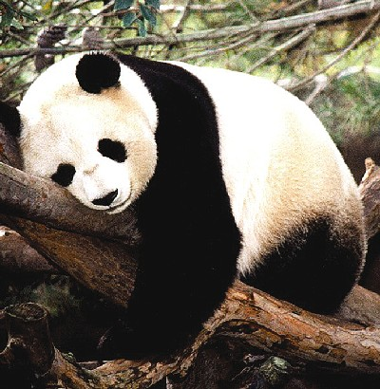
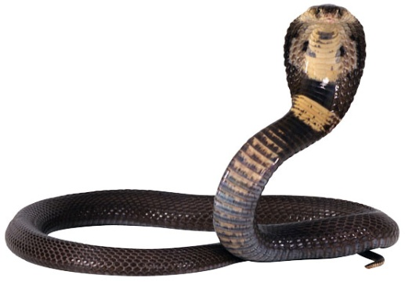
WILD ANIMALS
A panda – pandas
A Pole bear (a white bear) – Pole bears (white bears)
A crocodile – crocodiles
A snake - snakes

Slide 9
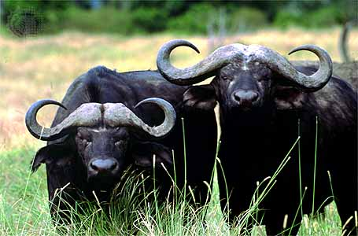
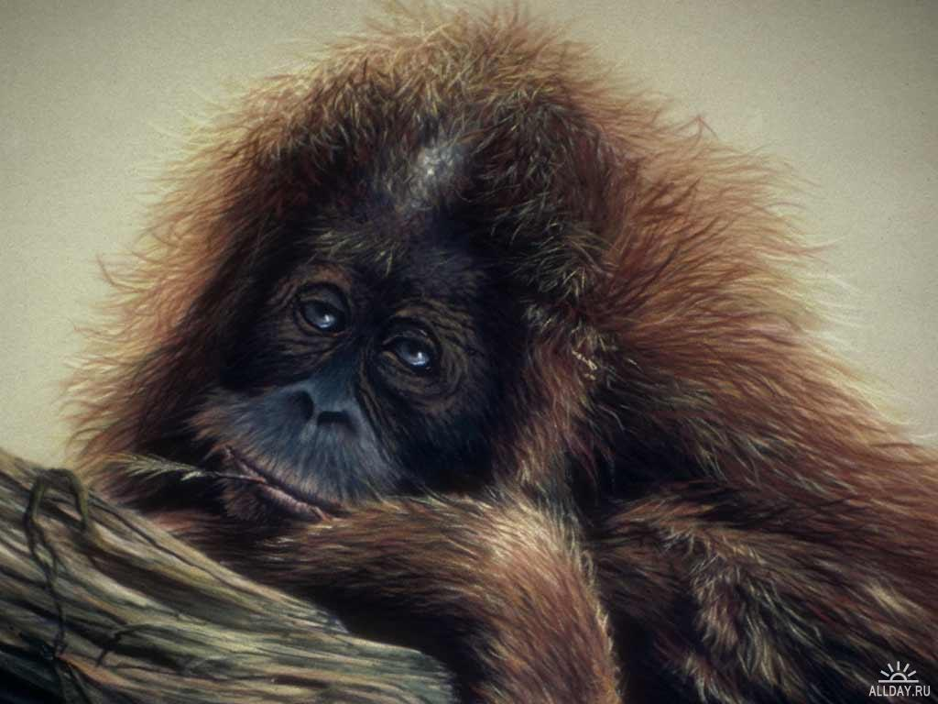
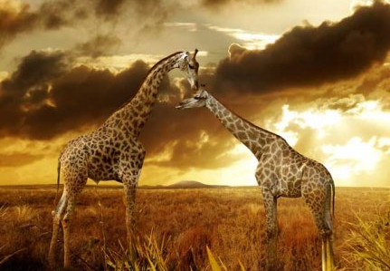
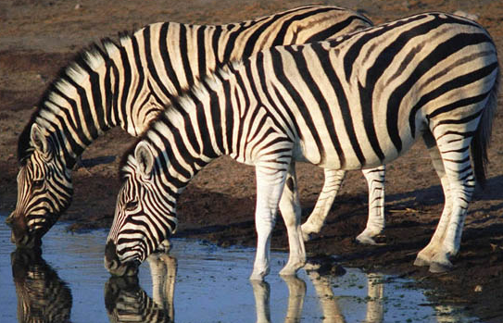
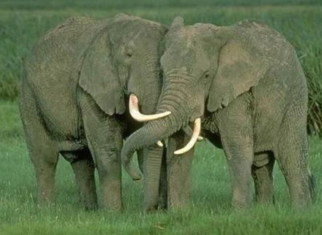
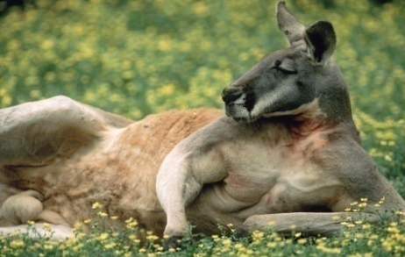
WILD ANIMALS
A buffalo – buffaloes
A giraffe – giraffes
An elephant - elephants
A hippo – hippos A zebra - zebras
A monkey – monkeys
A kangaroo – kangaroos

Slide 10
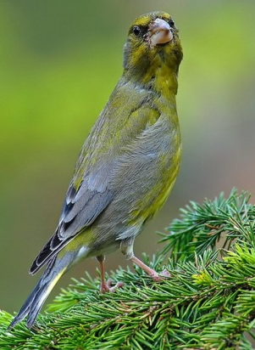
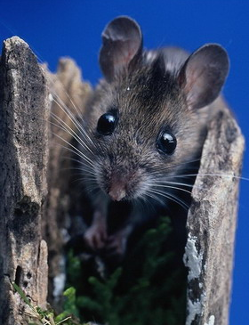
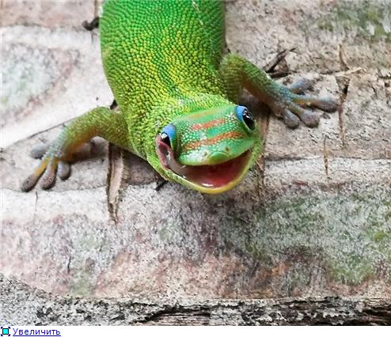
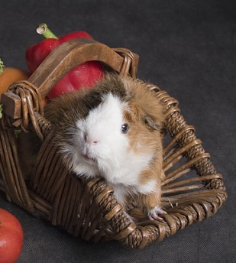
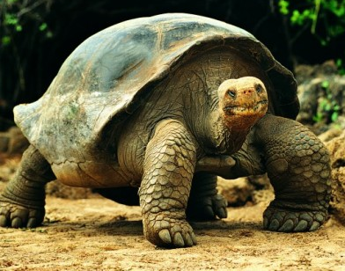
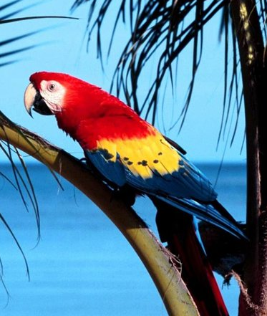
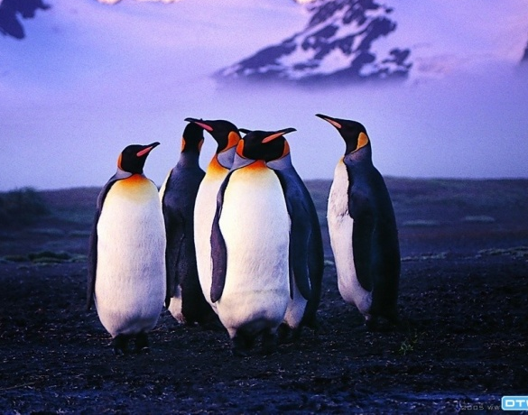
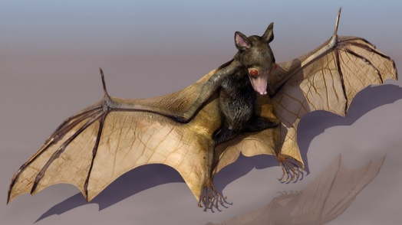
WILD ANIMALS
A frog – frogs
A lizard – lizards A bat – bats
A tortoise – tortoises
A hamster - hamsters
A bird – birds A mouse – mice
A parrot – parrots
A penguin – penguins

Slide 11
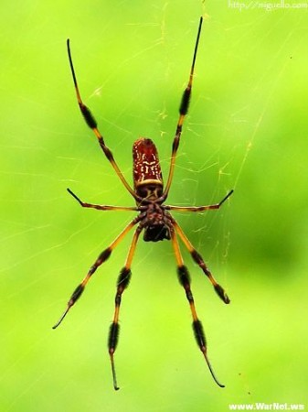
INSECTS
A butterfly - butterflies
A spider - spiders
A bug - bugs

Slide 12
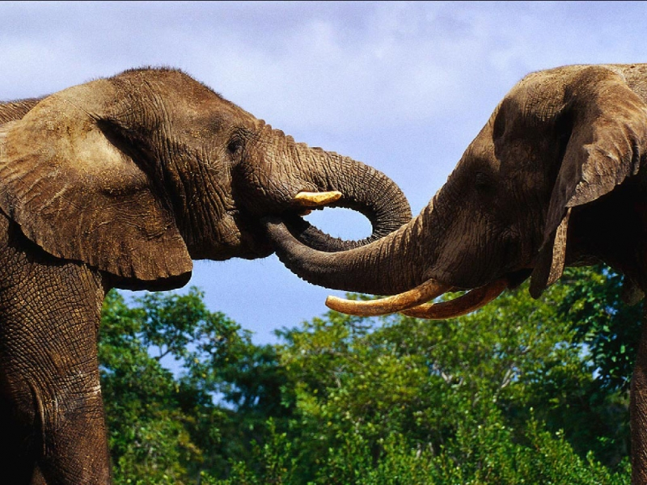
ANIMALS: DO SOME EXERSISES

Slide 13
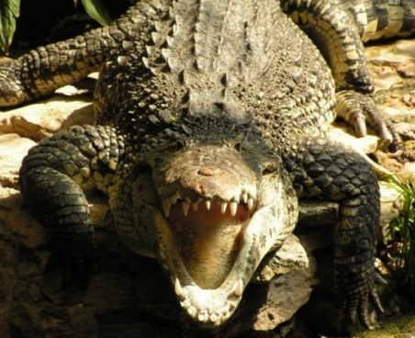
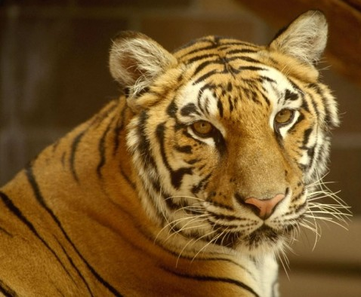
Poem: The Safari Park
Let’s go to the safari park
And see the animals before it’s dark!
The lion’s big and very strong,
And the kangaroo is jumping along!
The elephant is strong and grey,
The little panda is sleeping all day!
The big and hungry crocodile
Is watching at me with a big toothy smile!
A monkey high up in the tree,
Is looking down and smiling at me!
Now have a look at a big brown bear;
And a tiger too, but please don’t stare!

Slide 14
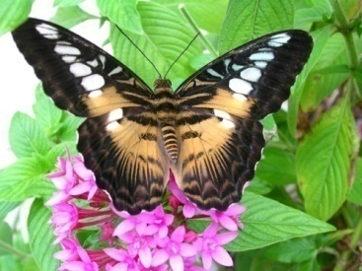
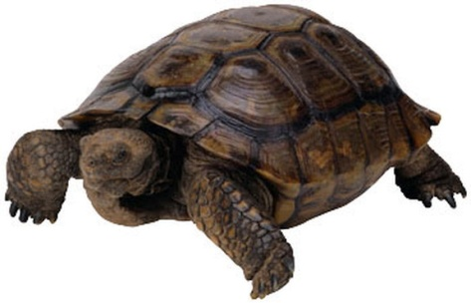
PLEASE, WRITE DOWN HOMEWORK!

