Slide 1
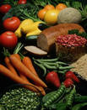
FOOD AND SHOPPING
Plan:
To know new words
To do lexical exercises
To write down the words into vocabularies
To play a game and learn a poem
To write down homework tasks

Slide 2
FRUITS

Slide 3
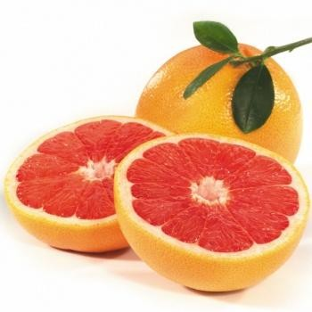
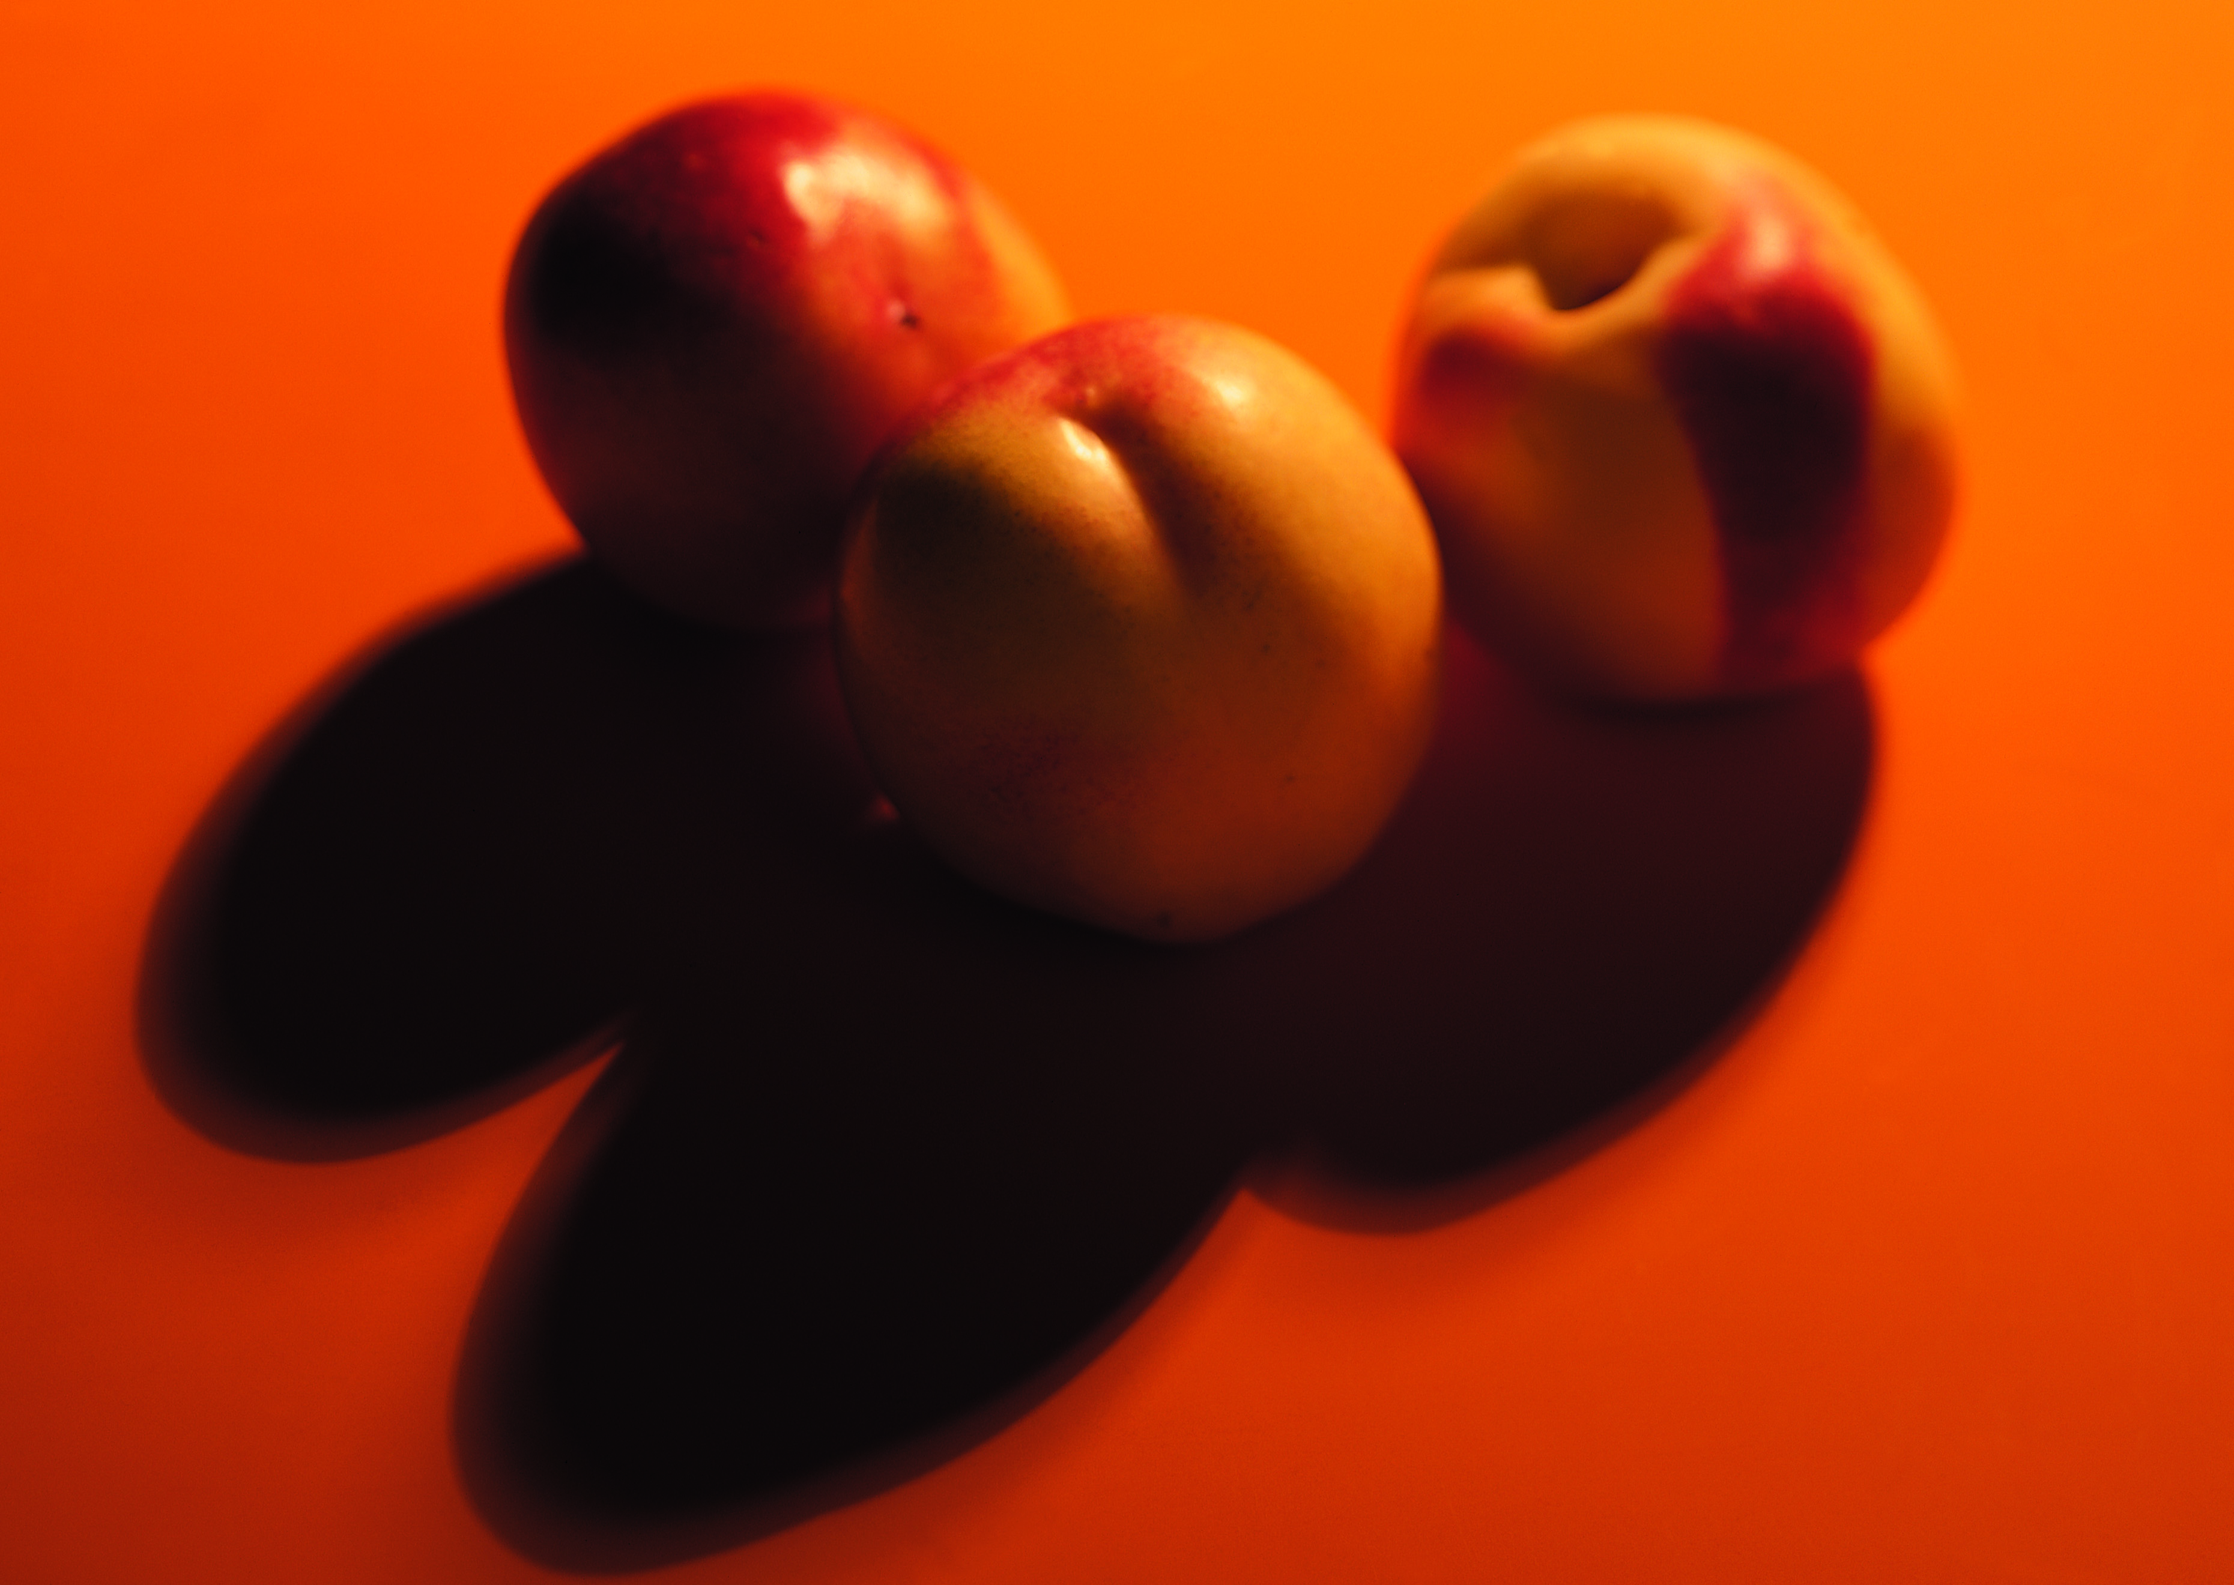
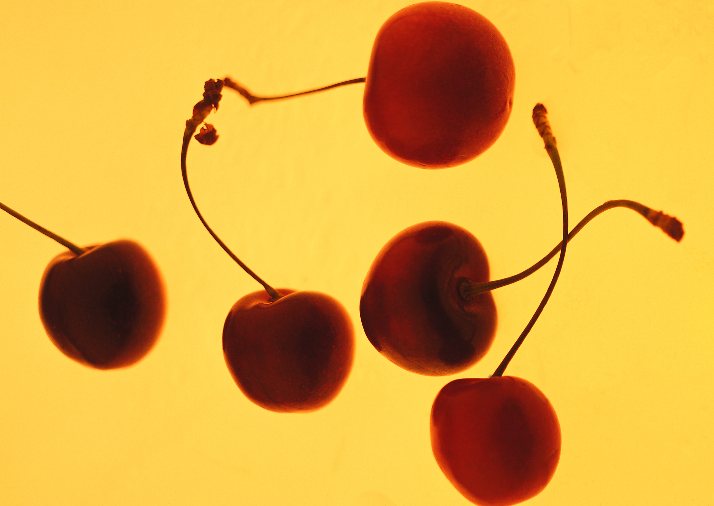
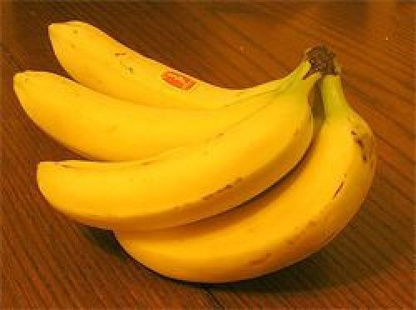
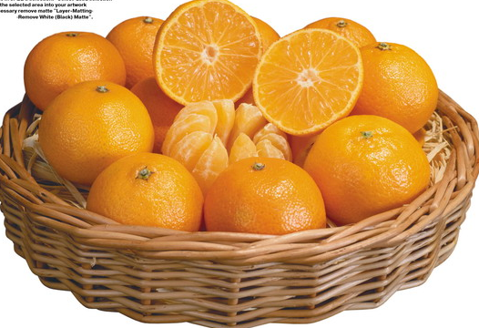
KINDS OF FRUIT
A peach – three peaches
An apple – two apples
A grapefruit – grapefruits
A cherry – a lot of cherries
A banana – bananas
An orange – oranges

Slide 4
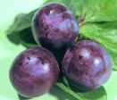
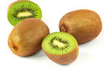
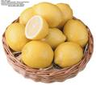
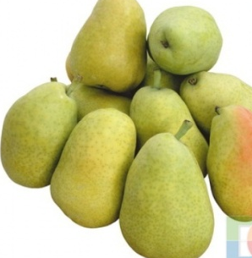
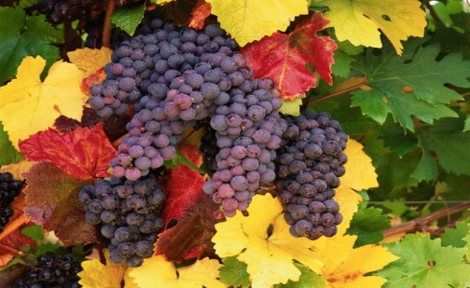
KINDS OF FRUIT
A kiwi - kiwis
A pine-apple – pine-apples
A plum – plums
A lemon - lemons
A pear - pears
A berry – berries
A water-melon – watermelons
A grape – grapes

Slide 5
VEGETABLES

Slide 6
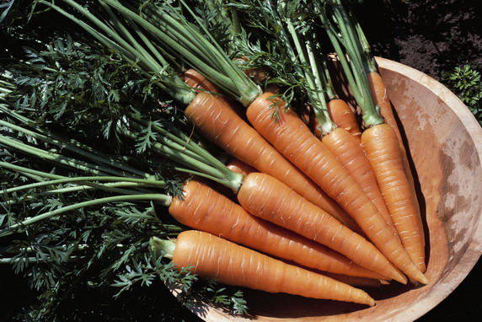
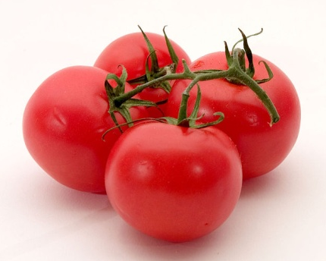
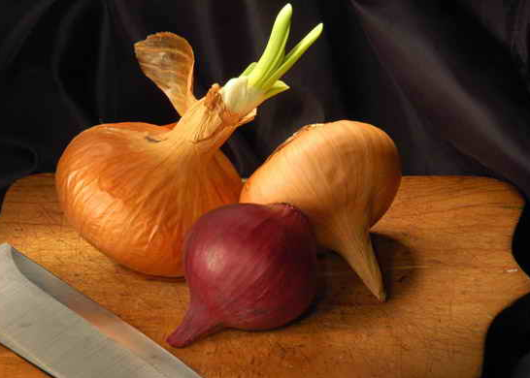
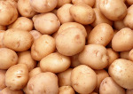
KINDS OF VEGETABLES
A carrot - carrots
A cabbage – cabbages
A cucumber - cucumbers
A tomato - tomatoes
A pepper - peppers
An onion - onions
A potato - potatoes

Slide 7
MEAT

Slide 8
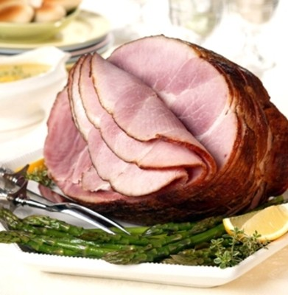
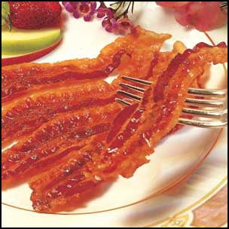
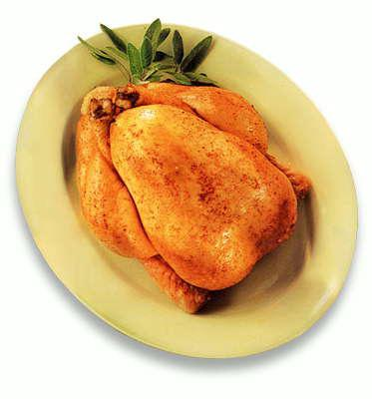
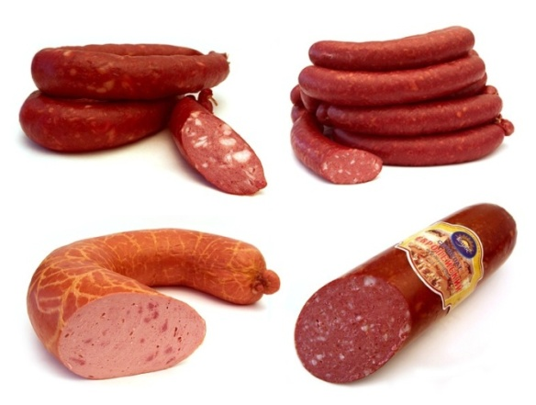
KINDS OF MEAT
HAM
BECON
MEAT
CHICKEN
SUASAGE - SUASAGES

Slide 9
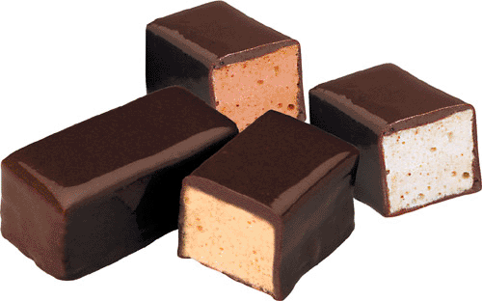
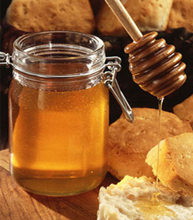
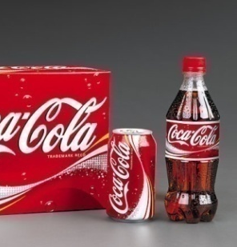
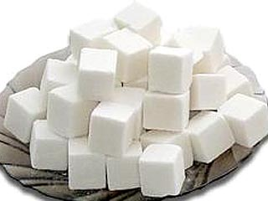
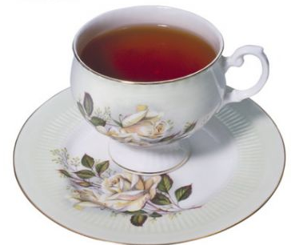
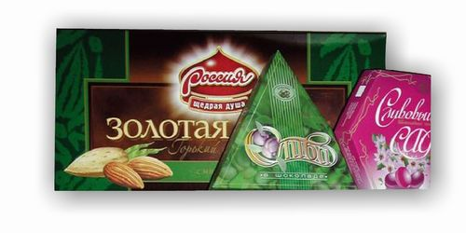
OTHER FOOD
DRINKS
SWEETS
A sweet - sweets
juice
milk
Cola
honey
tea
sugar
coffee
chocolate

Slide 10
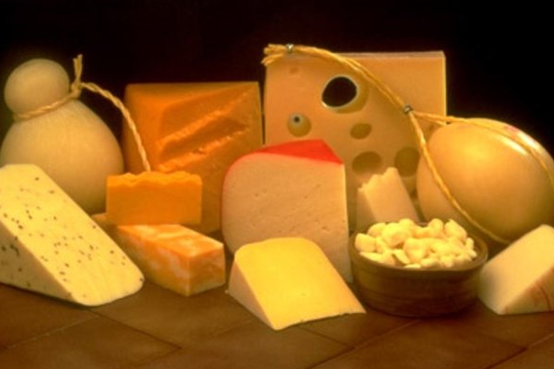
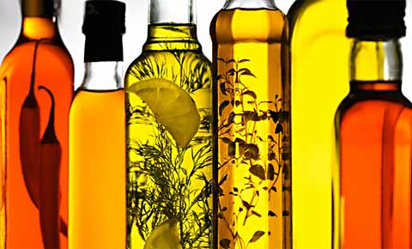
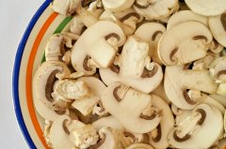
OTHER FOOD
oil
cheese
An egg - eggs
Ice-cream
butter
A mushroom - mushrooms

Slide 11
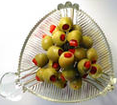
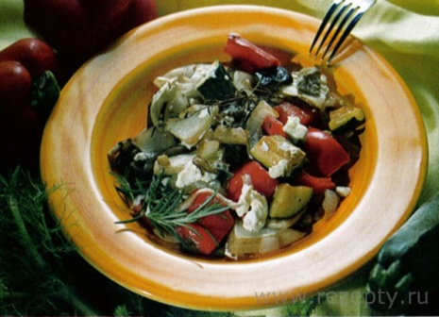
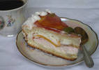
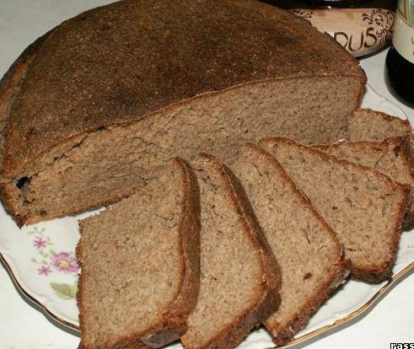
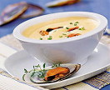
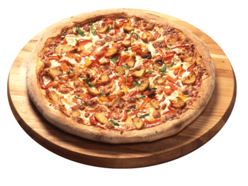
OTHER FOOD
olives
A cake - cakes
A bun – buns
salad
A pie - pies
soup
bread
omelets
pizza

Slide 12
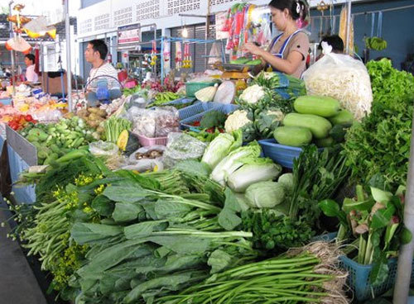
POEM
SHOPPING! SHOPPING!
Let’s GO SHOPPING!
We shall BUY a lot of FOOD!
BREAD and APPLES,
CHEESE and ORANGES!
I think they TASTE so good!

Slide 13
Write down homework

