Slide 1
SPORTS
PLAN:
To revise kinds of sports
To know new words about sport
To work with Student’s Books
To make up word combinations
To do some exercises
To write down homework task

Slide 2
KINDS OF SPORTS

Slide 3
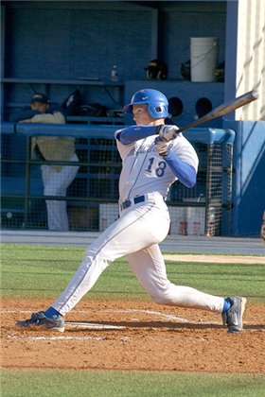
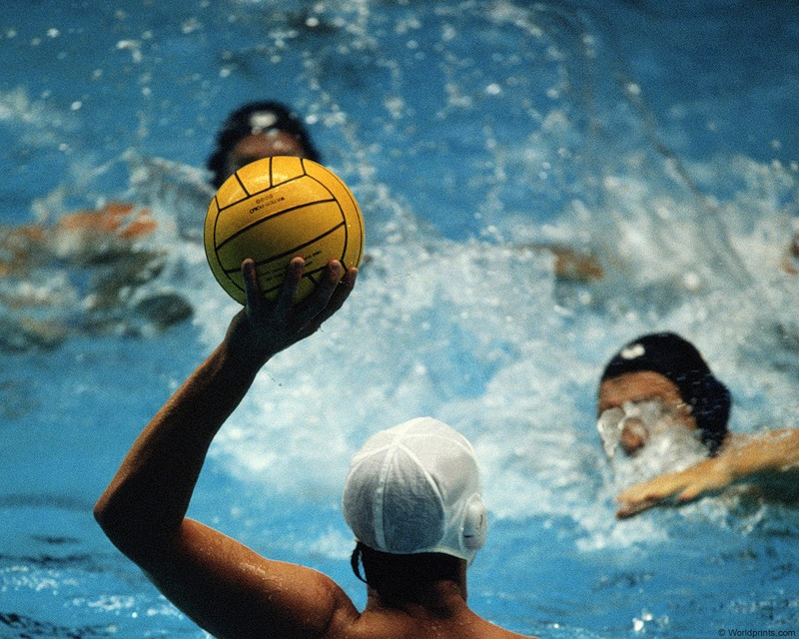
GAMES WITH A BALL
basketball
water polo
baseball

Slide 4
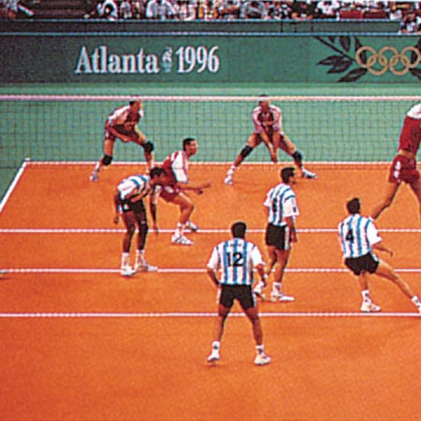
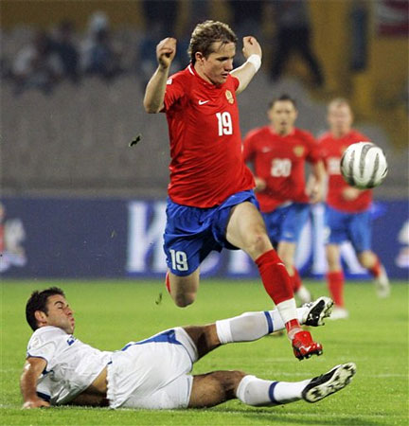
GAMES WITH A BALL
volleyball
football

Slide 5
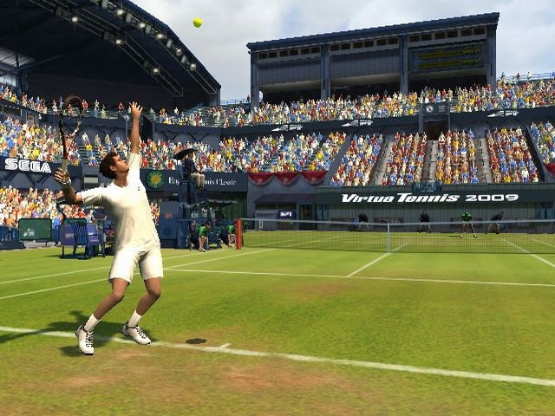
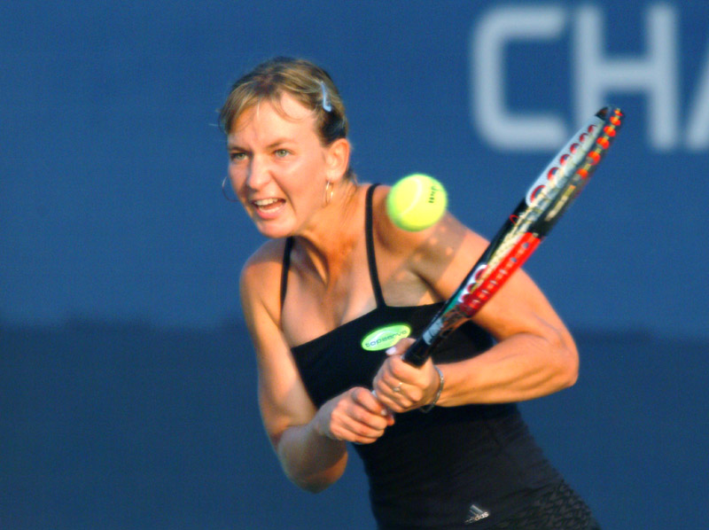
GAMES WITH A BALL
tennis
ping pong

Slide 6
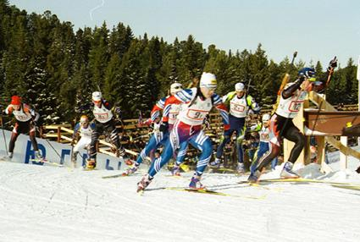
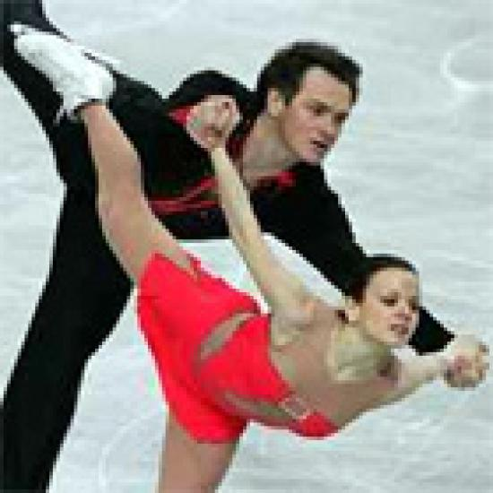
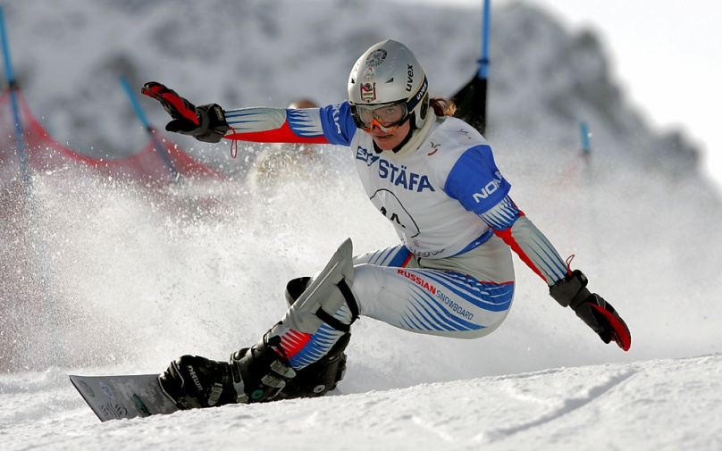
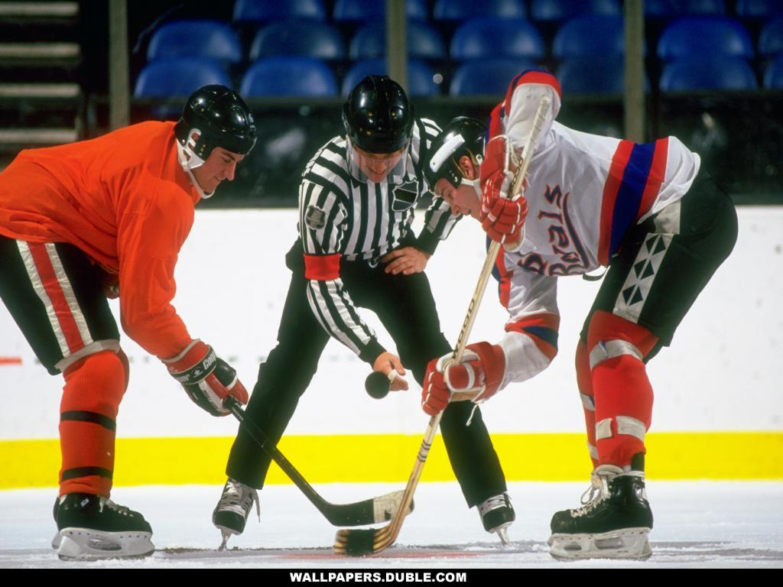
WINTER SPORTS
skating
skiing
hockey
snowboarding

Slide 7
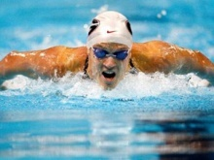
WATER SPORTS
surfing
swimming
water polo

Slide 8
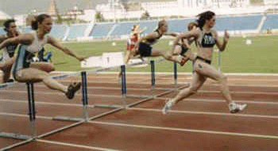
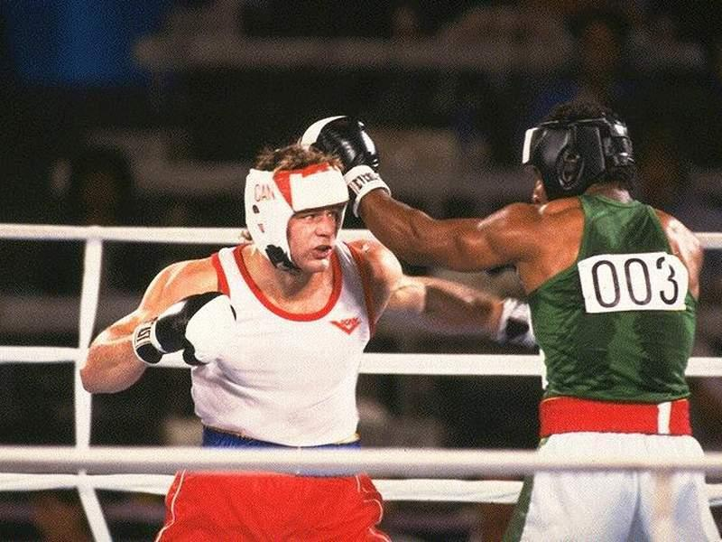
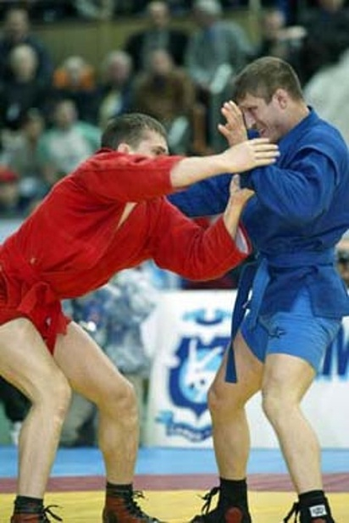
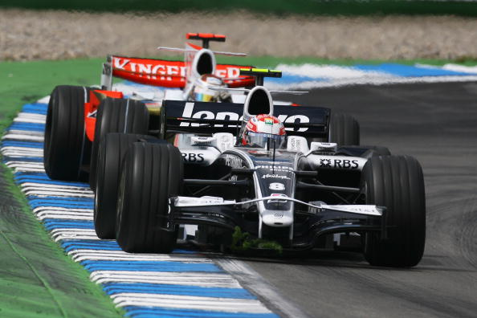
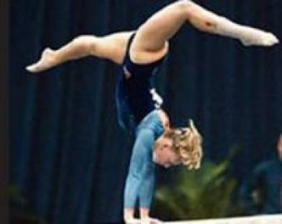
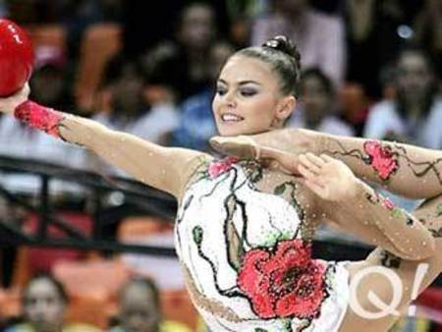
OTHER KINDS OF SPORTS
athletics
boxing
wrestling
car racing
gymnastics

Slide 9
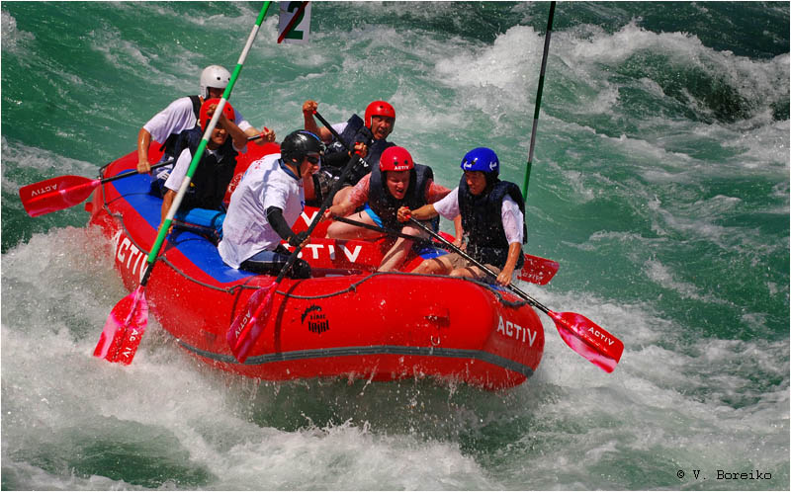
NEW WORDS AND WORD COMBINATIONS
Extreme sports
Pastime
Activity
Competition
Forward
Defender
Challenge
Skiing
Skating
Snowboarding
Sport club
To play
To compete
To earn
To join
To score a goal
To train
Brave
Exciting
To be a coach potato
To be fun
To be interested in
To do gardening
To do sports
To go dancing
To go horse-riding
To go jogging
To go swimming
To take part in

Slide 10
Make up word combinations match verbs in the 1st column with nouns in the 2nd column
To go
To do
To play
To score
To take
To be
To join
To compete
To swim
a sport club
in the pool
skating
part in
a goal
fun
in tennis
gymnastics
football

Slide 11
FILL THE TABLE WITH THE NOUNS
To go
To do
To play
football
Football, swimming, water polo, gardening, jogging, skating, baseball, gymnastics, skiing, boxing, athletics, house riding, snowboarding, dancing, basketball, wrestling.

Slide 12
WRITE DOWN YOUR HOMEWORK

